Slide 1
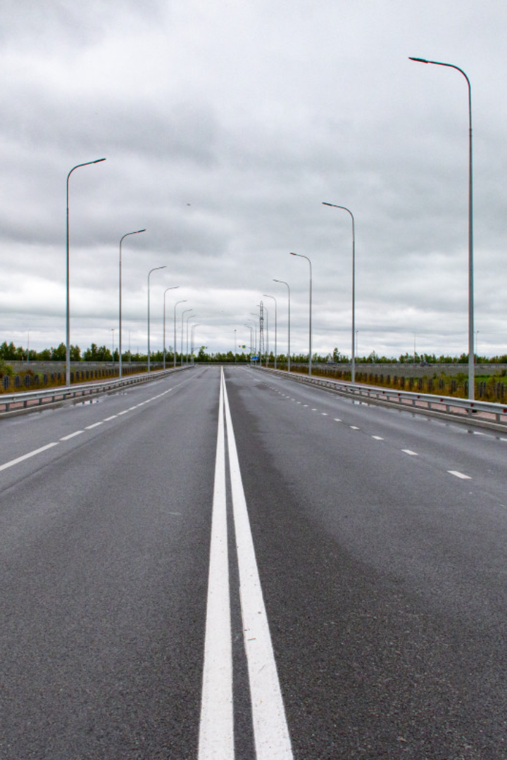
Lane Line Detection using Image Processing
Welcome to the world of lane line detection! In this presentation, we will explore the objective, methodology, and novelty of this fascinating computer vision technique.
Name
PRN Number
Roll Number
Rutuja Ulpe
22220148
373071
Mrudula Wakodkar
22220203
373072
Gaurav Lokhande
22220310
373077
Ramakant Tati
22220286
373076

Slide 2

Introduction
Welcome to our presentation on Lane Line Detection! In this project, we focus on developing advanced algorithms and techniques to accurately detect and identify lane lines on roads. Our goal is to enable safer and more efficient driving experiences, paving the way for autonomous vehicles and driver-assistance systems. Join us as we explore the fascinating world of lane line detection and its wide-ranging applications.

Slide 3

Objective
Precise Lane Identification
Real-time Processing
Robustness
Handling various challenging conditions such as different lighting conditions, road environments, and inclement weather is a key objective to ensure reliable detection.
The primary objective is to accurately detect and identify lane lines on roads, enabling various applications like autonomous driving and advanced driver-assistance systems.
Efficiency is crucial! The goal is to achieve real-time processing, allowing lane line detection to be performed in real-world scenarios without noticeable delays.

Slide 4
Challenges Faced During Lane Line Detection
While lane line detection can be a powerful tool, it comes with its own set of challenges. In this presentation, we will explore some of the most common challenges faced during lane line detection and how they can be overcome.
Some of the challenges that we will cover include:
Dealing with poor lighting conditions
Handling curved roads
Detecting lane lines in adverse weather conditions
Handling occlusions and other obstacles on the road

Slide 5
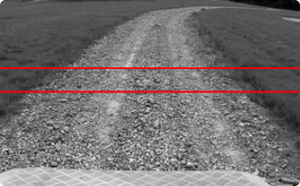
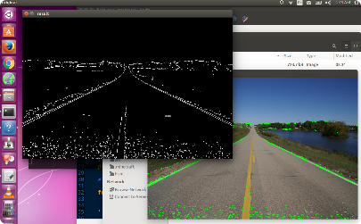
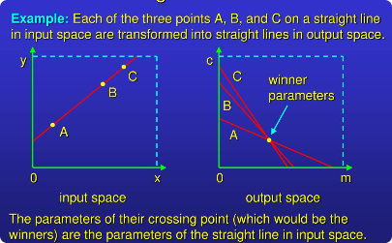
Methodology
Edge Detection
Apply Color Selection
Hough Transform
Extracting edges from the image to identify potential lane line pixels, often utilizing popular algorithms like Canny edge detection and Sobel operators.
Using color-based filtering to isolate lane line colors and enhance their visibility in the image.
Converting the edge pixels to parameter space to detect lines, employing the Hough Transform algorithm to robustly identify lane lines even under noisy conditions.

Slide 6

Novelty
Adaptive Lane Detection
Color-based Lane Segmentation
Integration with Navigation Systems
Developing algorithms that can adapt to different road conditions, such as varying lane widths, lane curvature, and road markings, to ensure accurate and reliable detection.
Utilizing color-based segmentation techniques to isolate lane lines from complex backgrounds and improve the accuracy of lane line detection.
Exploring how lane line detection can be seamlessly integrated with navigation systems to provide real-time lane guidance information to drivers for increased safety.

Slide 7

Pipeline Architecture:
Load test images.
Apply Color Selection
Apply Canny edge detection.
Apply gray scaling to the images.
Apply Gaussian smoothing.
Perform Canny edge detection.
Determine the region of interest.
Apply Hough transform.
Average and extrapolating the lane lines.
Apply on video streams.

Slide 8

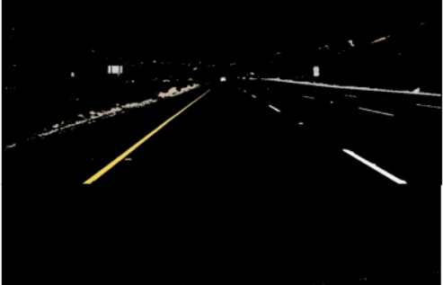
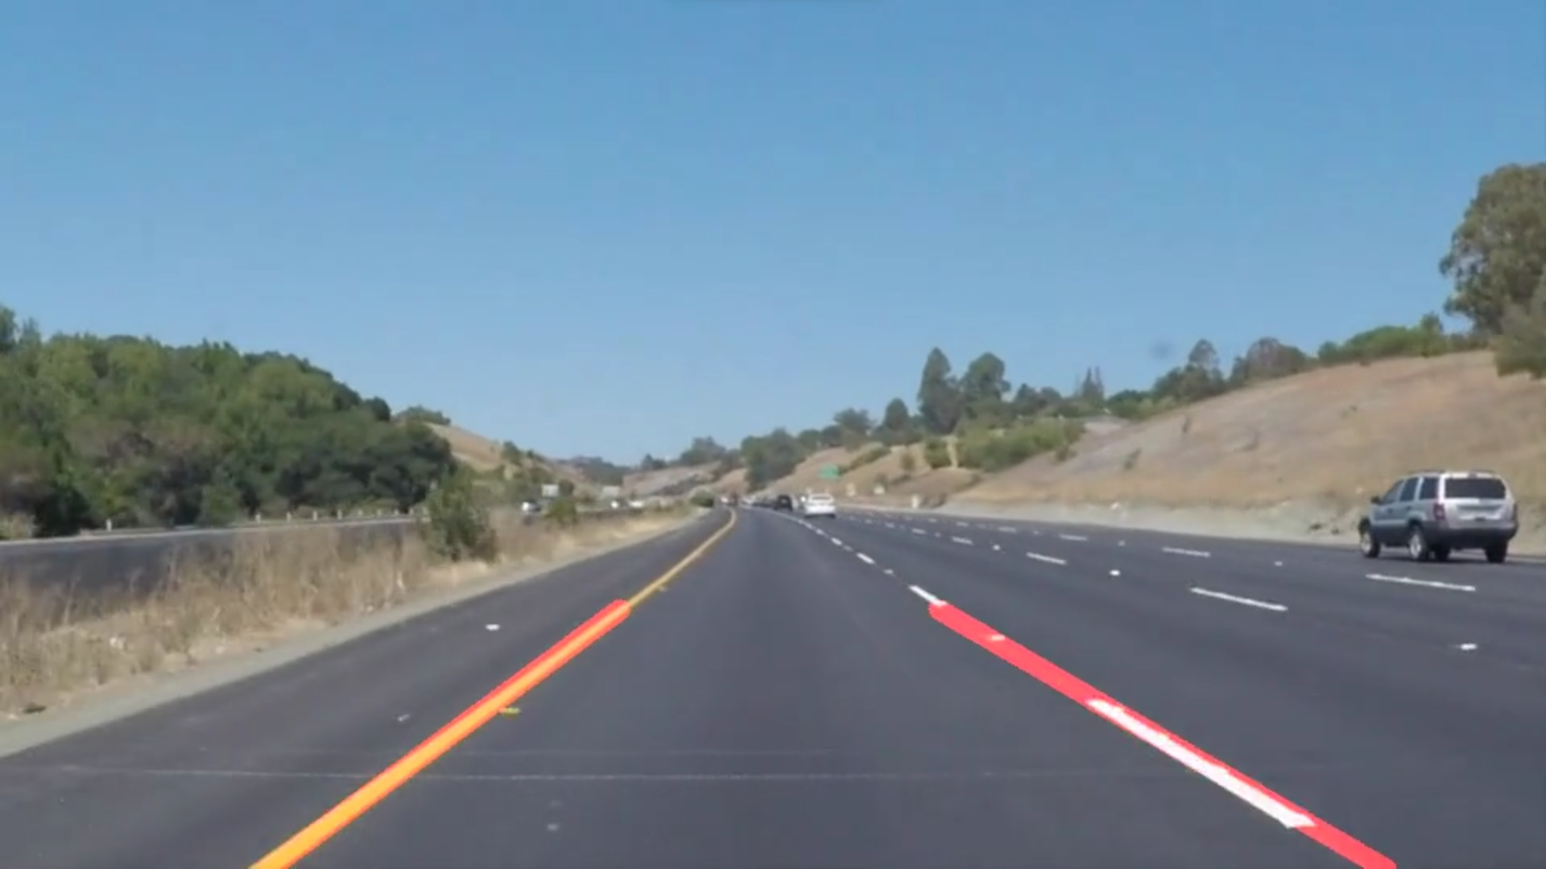
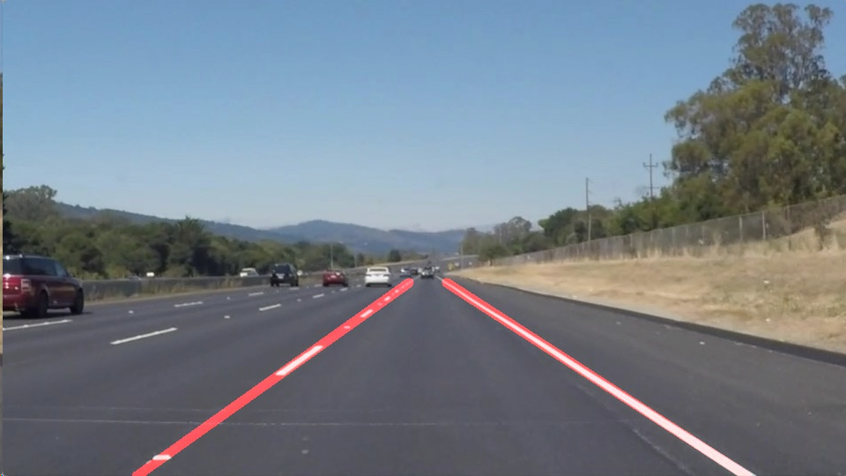
Output:
Color masking
Applying on original image

Slide 9
Application of the Project
1
Traffic Management
2
Autonomous Vehicles
3
Driver Assistance Systems
Implementing lane line detection systems to monitor and manage traffic flow on roads and highways, optimizing traffic signal timings and reducing congestion.
Integrating lane line detection algorithms into autonomous vehicles to enable accurate lane keeping and lane changing capabilities, ensuring safe and reliable autonomous navigation.
Incorporating lane line detection technology into driver assistance systems, providing visual and audible warnings to drivers when they deviate from their lane, enhancing overall road safety.

Slide 10

Conclusion
Lane line detection plays a crucial role in improving road safety and enabling advanced autonomous driving technology. Through continuous advancements and novel approaches, we can achieve more accurate, robust, and adaptable lane line detection systems.

Slide 11

References
Road Lane-Lines Detection in Real-Time for Advanced Driving Assistance Systems
Lane Detection Techniques using Image Processing

Slide 12

Thank You!
We would like to express our gratitude for your time and attention. Your support and interest in our project are greatly appreciated. If you have any further questions or would like to learn more, please don't hesitate to reach out to us. Thank you once again!

